Slide 1
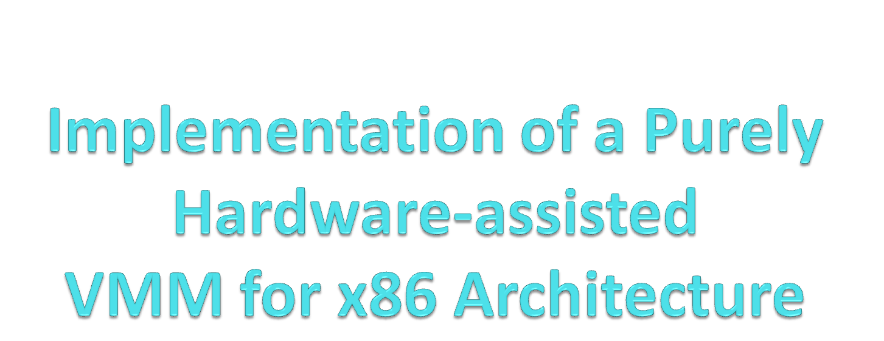
Saidalavi Kalady
Dept. of Computer Science & Engineering
National Institute of Technology , Calicut
Kerala,
India

Slide 2
Outline
What is Virtualization?
Why Virtualization?
Techniques for Virtualization
Challenges to x86 Virtualization
AMD SVM architecture
HVMM Design
Implementation details
Result
References

Slide 3
Virtualization
Virtualization - Abstraction of computer resources
Platform Virtualization - Running multiple OS concurrently

Slide 4
VMM
A Virtual Machine Monitor (VMM)
  Virtualization software
  controls the execution of multiple guest OS on a single physical machine

Slide 5
Why Virtualization ?
Under Utilized Servers
  High Running & Maintenance cost
Reliability
  Isolate software faults.
Security
  Isolate security faults
Notes:
Most of the applications running in servers today use only around 10-15 % of their capacity
Running and maintenance cost of servers are around 5 times the initial cost.

Slide 6
Virtualization Techniques
Full Virtualization
Para-Virtualization
Hardware Assisted Virtualization

Slide 7




HVMM
VMM, a thin layer residing directly on top of the Hardware

Slide 8
Architectural Requirements
The method of executing non-privileged instructions must be roughly equivalent in both privileged and user mode.
There must be a method such as a protection system or an address translation system to protect the real system and any other VMs from the active VM.
There must be a way to automatically signal the VMM when a VM attempts to execute a sensitive instruction. It must also be possible for the VMM to simulate the effect of the instruction.

Slide 9
Sensitive Instructions
Instructions that attempt to change or reference the mode of the VM or the state of the machine.
Instructions that read or change sensitive registers and/or memory locations such as a clock register and interrupt registers.
Instructions that reference the storage protection system, memory system, or address relocation system.
All I/O instructions.

Slide 10
x86 architecture and VMMs
17 x86 instructions don’t meet the requirement for virtualization
x86 architecture has sensitive non privileged instructions like SGDT, SIDT, and SLDT.
Processor has only one LDTR, IDTR, and GDTR.
There are problems with SMSW, PUSHF, POPF, PUSH,POP,CALL etc.

Slide 11
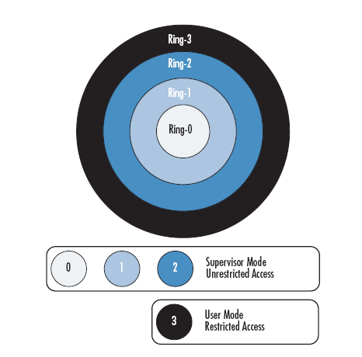
Challenges to x86 Virtualization

Slide 12
AMD SVM architecture
Processor Virtualization support
Memory Virtualization support
Interrupt Virtualization support

Slide 13
AMD SVM Instructions
VMRUN
  Start execution of a guest
VMSAVE,VMLOAD
  Save / reload the VM state between VM switches ( in/from the VMCB)
VMMCALL
  Explicitly transfer control from VM to VMM

Slide 14
VMCB
One for each running guest OS. It is divided into two
Control Area
  Various control bits that determine what actions cause #VMEXIT
State Area
CPU state for each guest is saved in this area

Slide 15


VMRUN Instruction
Transfers control from VMM to the guest VM
#VMEXIT Exception occurs & VMM gets control when selected sensitive instructions which require emulation are executed
VMM
VM
….
VMRUN
…
…
World switch

Slide 16
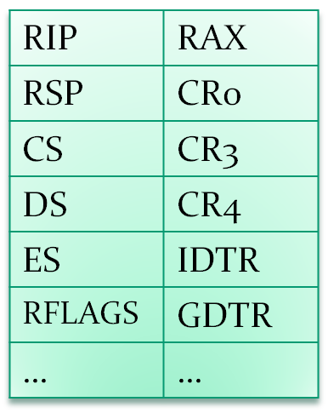
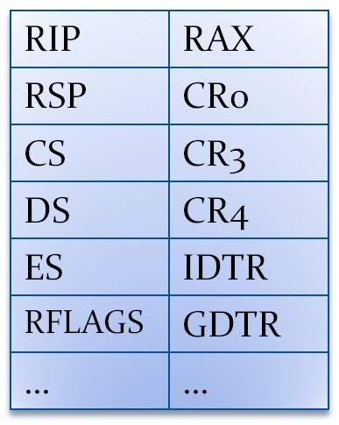

VMRUN
MACHINE STATE
Virtual Machine
Control Block
VM_HSAVE_AREA
MSR

Slide 17
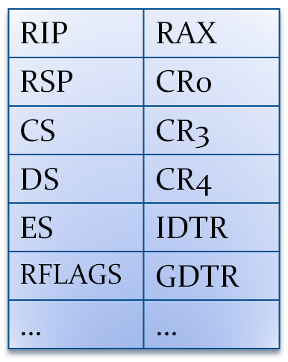
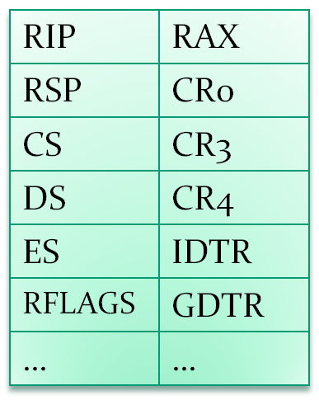


#VMEXIT
MACHINE STATE
Virtual Machine
Control Block
VM_HSAVE_AREA
MSR
CAUSE OF VMEXIT
ERROR CODE

Slide 18
Memory Virtualization
Nested Paging
Tagged TLB

Slide 19
Nested Paging
Two Level Page Translation Mechanism
  Guest Virtual to Guest Physical
  Guest Physical to Machine Physical
Each VM can have a mutually exclusive & independent physical address space

Slide 20







Effective Address Translation
With Nested Paging
VM virtual address
gCR3
VM Physical address
gPT
hCR3
Machine Physical address
pPT
hPT
Machine CR3

Slide 21
Tagged TLB
  Each guest has its own address space
  TLB is tagged with ASID
  Avoids Cache Flushing on VM Switching

Slide 22
Interrupt Virtualization
When an interrupt occurs during VM execution
  #VMEXIT transfers control to VMM
  VMM handles the interrupt
  Control is then given back to VM

Slide 23
Kernel Development
Design of a simple x86 based OS kernel with the following functionalities.
  Multiboot compatibility
  Basic Segmentation setup
  Paging setup
  Naïve memory allocation
  Interrupt handling
  Timer, Keyboard and Monitor support

Slide 24

















Control Flow
Setup Stack
Bios
Initialize Kernel
Boot Loader
Initialize Video
Install GDT
Kernel Startup
Setup Descriptors
Install Timer
Install IDT
Loop Forever
Install Keyboard
Enable Interrupts
Initialize Paging

Slide 25
Development Environment
Languages : C, Nasm Assembly
OS : 32-bit Windows XP
'C' Compiler : DJGPP
Assembler : nasm
Linker : GNU ld
Image Creator : WinImage
Emulator : Bochs
BootLoader : GRUB

Slide 26
Multiboot Compliance
Multiboot - a standard to which GRUB expects a kernel to comply
A mechanism to pass hardware information to the kernel

Slide 27
Interfacing 'C' and Assembly code
DJGPP Call Conventions
  All parameters to a function are passed on the stack.
  The parameters are pushed right-to-left.
  The return value of a function is returned in EAX.
From Assembly to ‘C’
  Push arguments if any onto the stack
  Call the Function Name

Slide 28
Initializing Video
We use the VGA framebuffer
  An array of 16-bit words, each representing the display of one character
  Memory-mapped starting with address 0xB8000
Displaying a character involves
  Storing its ASCII value at the mapped memory location
  Updating the hardware cursor

Slide 29
Display Routines
  moveCursor()
  scroll()
  clearScreen()
  PutChar(char)
  putNum(num)
  putHex(num)
  putStr(char *)

Slide 30
Descriptor Table Setup
Global Descriptor Table
  Memory Protection Method
  Array of segment descriptors
Interrupt Descriptor Table
  Interrupt Handling Mechanism
  Array of pointers to Interrupt Handler Routines

Slide 31
GDT Setup
Minimal Segmentation Setup
  Setup NULL, Code and Data Segment Descriptors in the GDT structure
Install Segment Information
  Point GDTR to the base address of the GDT array using lgdt instruction
  Fill Segment Registers with Descriptor offsets
    CS with Code offset
    DS, ES, FS, GS, SS with Data

Slide 32
IDT Setup
Initialize the IDT
  Map Handler Routines for Faults and Exceptions to interrupt numbers 0 to 31
  Remap the PIC IRQ0..IRQ15 at interrupt numbers 32 to 47
Install Interrupt Information
  Point IDTR to the base of the IDT array using the lidt assembly instruction
Enable Interrupts

Slide 33
Timer Setup
Using Programmable Interval Timer
  Connected to IRQ0 of PIC
  Can be programmed to fire off interrupts at required intervals
Install our timerHandler() routine in our IDT at interrupt number 32

Slide 34
Keyboard Setup
Using a microcontroller chip on the motherboard
  Connected to IRQ1 of PIC
  Data and Control registers used for communication
Install our keyboardHandler() routine in our IDT at interrupt handler 33

Slide 35
Paging Setup
Physical Memory Manager
Virtual Memory Manager
Setup Paging Information
Enable Paging

Slide 36
Physical Memory Management
Entire Physical memory divided into frames
A Bitmap keeps track of free and used frames
Frame routines
  initializeFrameBitmap(mem_size)
  setFrame(frame_no)
  clearFrame(frame_no)
  isFramed(frame_no)
  findFreeFrame()

Slide 37
Virtual Memory Management
Naïve Memory allocation technique
  Initialize a pointer free_mem_start to the start of free memory.
  Allocate any chunk of memory starting here and increment free_mem_start
  No mechanism to free memory
Allocation Routine
  Address kalloc(u32 size, int align)

Slide 38
Setup Paging Information
Create the kernel page directory
  Allocate the directory structure
Populate the page directory
  Identity map the entire kernel into paged memory
Install Page Fault handler
  Interrupt number 14

Slide 39
Enable Paging
Set the Protection Enable (PE) bit in the CR0 register
Set the Paging enable (PG) bit in the CR0 register
Point CR3 to the physical address of the Kernel Page Directory structure

Slide 40
VMM Development
Initializing AMD SVM
Creating a VM
Booting a guest OS image within the VM

Slide 41











VMM Control Flow
Bios
Grub
HVMM
Initialize SVM
Hypervisor
Enable SVM
Setup Hypervisor
User Interface
Guest OS
Create VM
Reserve Hypervisor Memory
Allocate Host State Area
Create VMCB

Slide 42
Development Environment
Languages : C, GNU Assembly
OS : 64-bit openSUSE 10.3
'C' Compiler : GCC
Assembler : GAS
Linker : GNU ld
Image Creator : dd
Emulator : AMD Simnow
BootLoader : GRUB

Slide 43
Initializing AMD SVM
  Enable Extended Features
    Set EFER.SVME = 1
    Set EFER.LME = 1
  Copy the guest kernel module provided by grub to higher memory
  Reserve lower 1 GB of memory for the VMM
  Allocate Host Save Area for the VMM

Slide 44
Creating a VM
Create VMCB
  Allocate VMCB
  Setup VMCB Control Area
  Setup VMCB State Area
Load the ELF image of the guest OS into memory
Point VMCB.rIP to first instruction in guest
Set VMCB.INTR_MASK to force VMM level Hardware Interrupt handling

Slide 45
Booting a guest OS
Point rAX to the VMCB structure
Issue VMRUN instruction
Handle #VMEXIT

Slide 46
Comparisons of Switch Lag values
Processor | Clock Speed | Switch lag
AMD x2 Turion | 1.6 GHz | 89 ms
AMD x2 3800+ | 2.0 GHz | 79 ms
AMD x2 4400+ | 2.2 GHz | 75 ms

Slide 47
Future Work
64 bit interrupt handling
Scheduling Multiple Guest Operating Systems

Slide 48
References
[1] AMD, AMD64 Virtualization Codenamed Pacica
Technology Secure Virtual Machine Architecture
Reference Manual, Publication No.33047 Revision
3.01, May 2005
[2] AMD, AMD64 Architecture Programmer's Man-
ual,Volume 2:System Programming, Publication
No.24593 Revision 3.13, July 2007.
[3] AMD, AMD64 Architecture Programmer's Man-
ual Volume 3:General-Purpose and System Instruc-
tions,Publication No.24594 Revision 3.13, July 2007.
[4] Intel, \Intel Virtualization Technology," Intel Tech-
nology Journal, Volume 10, Issue 3, August 2006.

Slide 49
References
[5] POPEK, G. J., GOLDBERG, R. P., \Formal re-
quirements for virtualizable third generation archi-
tectures," ACM Communications,, July 1974
[6] Adams, Keith; Agesen; Ole, \A Comparison of Soft-
ware and Hardware Techniques for x86 Virtualiza-
tion," ACM International Conference on Architec-
tural Support for Programming Languages and Op-
erating Systems,, 2006.
[7] Rosenblum, Mendel; Garnkel, Tal. \Virtual ma-
chine monitors: current technology and future
trends," IEEE Computer, volume 38, issue 5, May,
2005.

Slide 50
References
[9] AMD, AMD SimNow v4.4.2 Simulator Users Man-
ual..
[10] http://web.yl.is.s.u-tokyo.ac.jp/ kaneda/tvmm/,
Tiny Virtual Machine Monitor.
[11] http://osdever.net/ , An introduction to OS devel-
opment.
[12] http://www.osdev.org/, Advanced OS development.

Slide 51


Slide 52
Thank you

